Slide 1

Design & Analysis of Algorithms
Dr. Alakesh Kalita
Mathematics and Computing
IIT ISM Dhanbad

Slide 2

B-Tree and B+ Tree

Slide 3
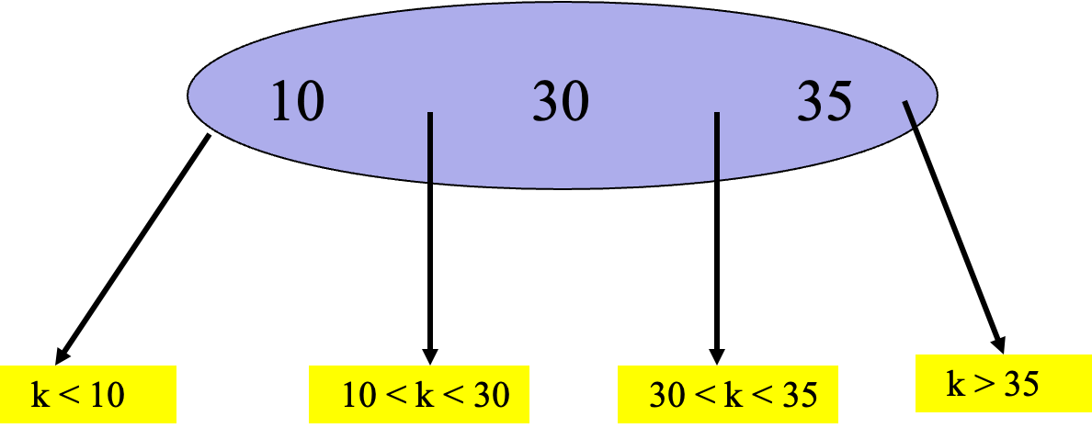
m-way Search Trees
arr = [10, 5, 15, 3, 7, 12, 18]
4-Way Search Tree
10
5
15
3
7
12
18
Each internal node has up to m – 1 keys and m children.
m = 2 => binary search tree.

Slide 4
Disadvantages of BBST
arr = [10, 5, 15, 3, 7, 12, 18]
AVL Trees
n = 2³⁰ = 10⁹ (approx).
30 <= height <= 43.
When the AVL tree resides on a disk, up to 43 disk accesses are made for a search.
10
5
15
Red-Black Trees
n = 2³⁰ = 10⁹ (approx).
30 <= height <= 60.
When the red-black tree resides on a disk, up to 60 disk accesses are made for a search.
This takes up to (approx) 6 seconds.
Not acceptable.
3
7
12
18

Slide 5
m-way Search Trees
Happens when all internal nodes are m-nodes.
Full degree m tree.
# of nodes = 1 + m + m² + m³ + … + m^{h-1}
= (m^{h} – 1)/(m – 1).
Each node has m – 1 keys.
So, # of keys = m^{h} – 1.
 | m = 2 | m = 200
h = 3 | 7 | 8 * 10⁶ - 1
h = 5 | 31 | 3.2 * 10¹¹ - 1
h = 7 | 127 | 1.28 * 10¹⁶ - 1

Slide 6

Indexing
Q. Search a topic if index page is not available.
Ans: Search all the chapters (Chapter wise BST)
Q. Search a topic if index page is available.
Ans: Only search on the index file.
10 Chapters (same # pages)
  5 Topics (same # pages)

Slide 7
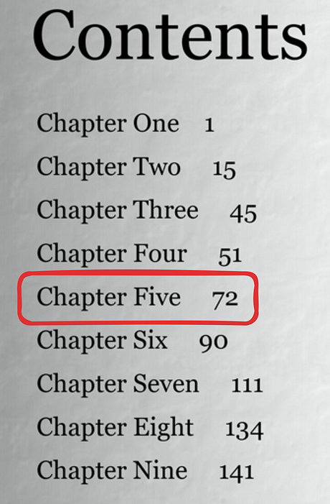
Multi-level indexing
Contents
Chapter 1 1
Chapter 11 2
.
.
Chapter 55 5
.
Chapter 110 10
Index of Index
Index is very large
10 Chapters (same # pages)
  5 Topics (same # pages)

Slide 8
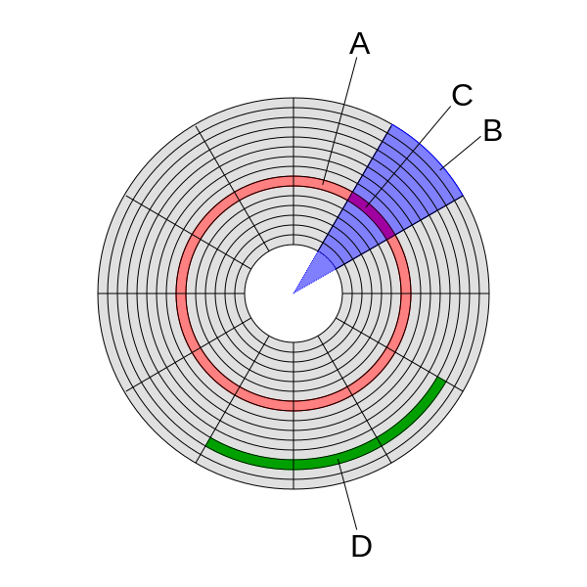

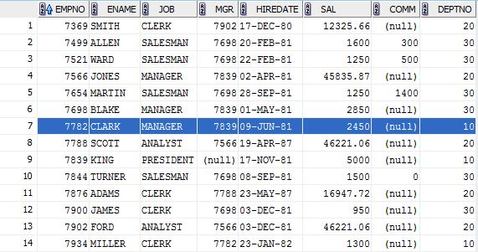
Multi-level indexing
Track
Block
Sector
Cluster
10 Chapters (same # pages)
  5 Topics (same # pages)
Records

Slide 9
Multi-level indexing
7369 | 1
7499 | 1
7902 | 5
7934 | 5
Block 1
Block 2
7369 | 1
17934 | 50
Block 1.1
Block 3
Block 4
Index
Block 1.50

Slide 10
Multi-level indexing
Primary key
1
1
Block Pointer
Record 1
2
1
2
Block 1
3
1
3
4
1
Record Pointer
4
10
1.1
5
1
5
20
1.2
6
2
Block 1.1
6
30
1.3
7
2
7
40
1.4
8
2
8
Block 2
Block 2.1
50
1.5
9
2
9
60
1.6
10
2
10
70
1.7
80
1.8
90
1.9
100
1.10
507
102
506
Block 2.6
510
1.51
508
102
Block 1.51
507
509
102
508
Block 102
510
102
509
510
Time to search a record = log(6) + 1
Time to search a record = log(51) + 1
Time to search a record = log(102) + 1

Slide 11
Multi-level indexing with m-way search tree
key
1
1
Block Pointer
Record 1
2
1
2
Block 1
3
1
3
4
1
4
10
1.1
5
1
5
20
1.2
6
2
Block 1.1
6
30
1.3
7
2
7
40
1.4
8
2
8
Block 2
Block 2.1
50
1.5
9
2
9
60
1.6
10
2
10
70
1.7
80
1.8
90
1.9
100
1.10
B-Tree and B+ Tree are based on multi-level indexing. But why do we need these trees?
Ans: To make multi-level indexing dynamic.
507
102
506
Block 2.6
510
1.51
508
102
Block 1.51
507
509
102
508
Block 102
510
102
509
510
Time to search a record = log(6) + 1
Time to search a record = log(51) + 1
Time to search a record = log(102) +1

Slide 12
Exercise (Sparse index)
Q. Data Records = 30000
Record size = 100 bytes
Block Size = 1024 bytes
Key size = 9 bytes
Block pointer = 6 bytes
Find the avg number of blocks to search with and without index?
Ans:
Number of Record per Blocks = 1024/100 = 10 (unspanned)
Number of Blocks requires for entire data = 30000/10 = 3000
Without index = log (3000)
Number of index entry per block =block size/ (key size + Block pointer)
= 1024/15 = 68
Number of blocks = 3000/68 = 45
With index = log(45)

Slide 13
Exercise (Dense Index)
Ans: Index entry size = key size + block pointer
= 16 bytes = 2⁴
Number of index entry = # data = 2¹⁴
In 1st level index table
Number of index record per Block = 2¹⁰/2⁴ = 2⁶
Number of Blocks in 1st level = 2¹⁴/2⁶ = 2⁸ = 256
Q. Data Records = 16384 = 2¹⁴
Record size = 32 bytes = 2⁵
Block Size = 1024 bytes = 2¹⁰
Key size = 6 bytes
Block pointer = 10 bytes
Find the number of 1st (dense index) and 2nd level blocks in multi-level indexing.
In 2nd level
Number of index entry = 256
Number Index record per Blocks = 2¹⁰/2⁴ = 2⁶
Number Blocks in 2nd level= 2⁸/2⁶ = 2² = 4

Slide 14
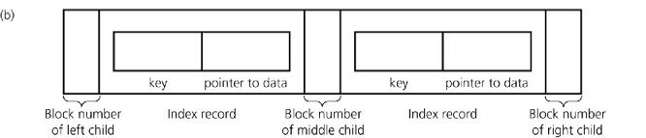
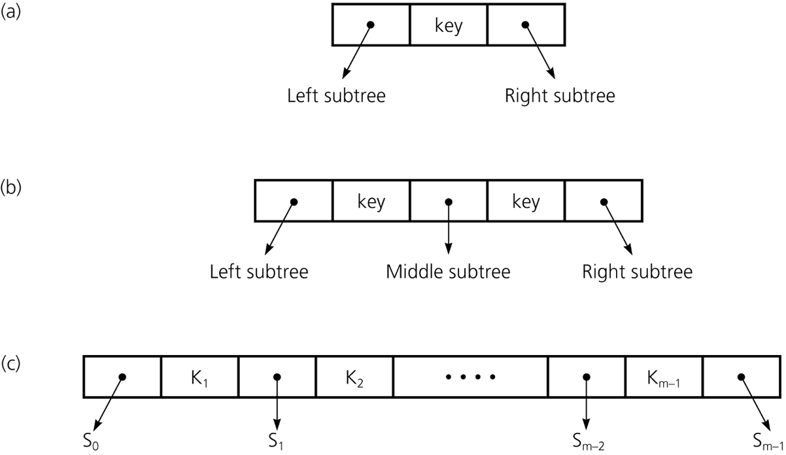
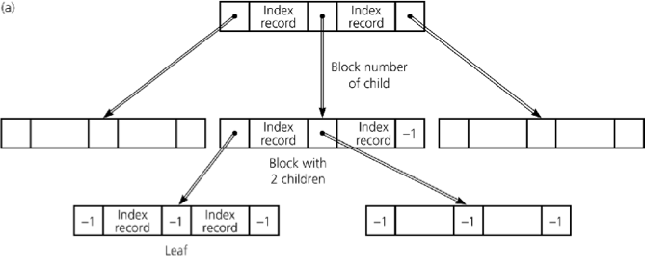
B-Tree
B-tree of order m.
Contains at max m-1 keys in each node.
Root has at least 2 children.
Remaining internal nodes (if any) have at least ceil(m/2) children.
External (or failure) nodes on same level.
Blocks organized into a 2-3 tree (B-Tree of order 3)

Slide 15
B-Tree
BP
K, RP
BP
K, RP
BP
BP
K, RP
BP
K, RP
BP
BP
K, RP
BP
K, RP
BP
BP
K, RP
BP
K, RP
BP
K, RP
K, RP
K, RP
K, RP
1
2
3
4
5
506
507
508
509
510

Slide 16
B-Tree
B-tree of order 5.
Node type |  | Min | Max | Min | Max
Root | BP | 2 | 5 | 2 | p
 | Key | 1 | 4 | 1 | p-1
Internal | BP | 3 | 5 | ceil(p/2) | p
 | Key | 2 | 4 | ceil(p/2)-1 | p-1
Leaf | key | 2 | 4 | ceil(p/2)-1 | p-1
Overflow: Inserting more than allowed nodes
Underflow: A node contains less than required nodes

Slide 17
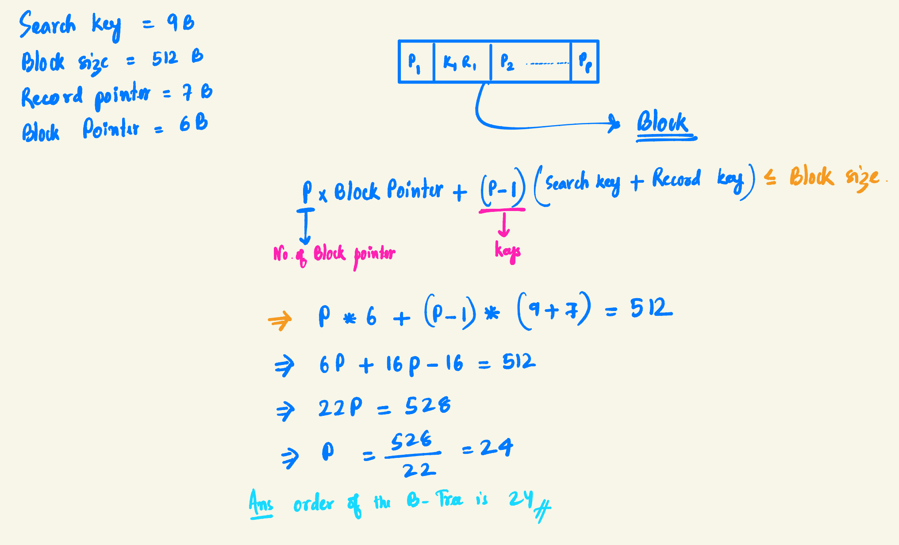
B-Tree: Exercises
Search key = 9 B
Disk block size = 512 B
Record pointer = 7 B
Block Pointer = 6B
Find the order of the B-Tree.

Slide 18
B-Tree: Exercises 2
The order of a B Tree is 23. Then how many index records will be stored in a 4 level (considering root at level 1) B-Tree.
BP
K, RP
BP
BP
KE/IE : 22
N: 23
KE/IE : 22*23
BP
K, RP
BP
BP
BP
K, RP
BP
BP
BP
K, RP
BP
BP
N: 23*23
KE/IE : 22*23*23
N: 23*23*23
KE/IE : 22*23*23*23

Slide 19
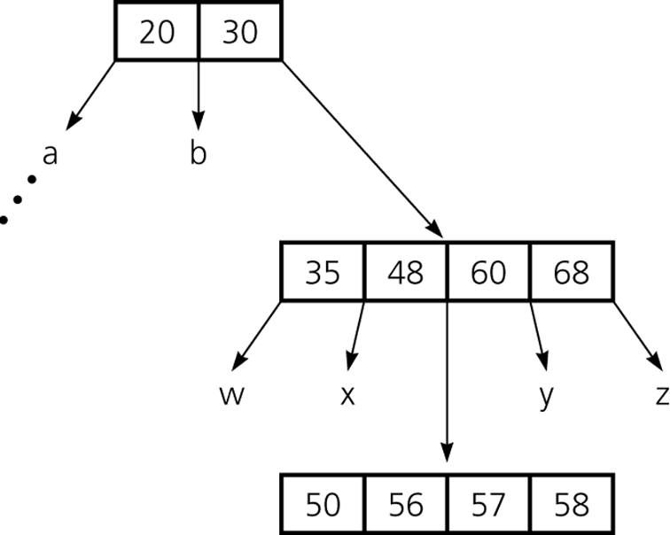
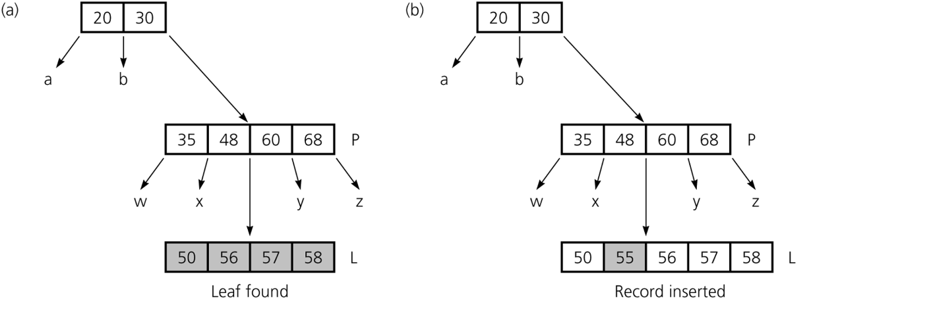
B-Tree: Insertion
Inserting 55
A B-tree of degree 5
Overflow

Slide 20
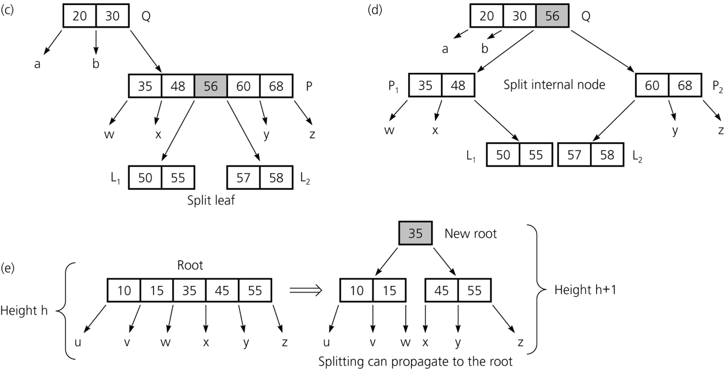
B-Tree: Insertion
Overflow

Slide 21
B-Tree: Insertion
Create B-Tree of order 4 using the following nodes
2 5 10 1 6 9 4 3 12 18 20 25

Slide 22
B-Tree: Deletion
P = 5
5 10 50 80
Deletion always occurs at the leaf.
3 4
8 9
20 28 29
Delete 10
Goto left (right) subtree
  Find the largest (smallest) element and replace with the to be deleted node.
5 9 50 80
3 4
8
20 28 29
Underflow

Slide 23
B-Tree: Deletion
P = 5
5 9 50 80
3 4
8
20 28 29
Underflow
5 20 50 80
Merge underflowing node (8) and take most populous sibling node (20 28 29), and middle element (9) from the parent node
3 4
8 9
28 29
8 9 20 28 29
Overflow
If overflow happens, swap new middle element (20) and previous middle element (9) and adjust the other elements accordingly

Slide 24
B-Tree: Deletion
P = 5
Merge underflowing node (4) and take most populous node (8, 9), and middle element (5) from the parent node
5 10 50 80
3 4
8 9
20 28 29
4 5 8 9
Delete 3
10 50 80
5 10 50 80
4 5 8 9
20 28 29
4
8 9
20 28 29
Underflow

Slide 25
B-Tree: Deletion
If the key is in a leaf node, delete it directly.
After deletion, check for underflow (i.e., the node has fewer than minimum keys).
If underflow, fix it by borrowing or merging.
If the key is in an internal node:
Find the predecessor (largest in left subtree) or successor (smallest in right subtree).
Replace the key with the predecessor/successor.
Recursively delete the predecessor/successor from the child node.
Underflow handling:
If a child has fewer than the minimum number of keys, fix it:
Borrow a key from the left or right sibling if the sibling has more than the minimum keys.
If borrowing is not possible, merge the underflowing node with a sibling and pull down the parent’s separator key.
If merging causes the parent to underflow, repeat the fix recursively.
The B-Tree may shrink in height if the root becomes empty after merges.
Overflow is typically handled during insertion, not deletion.
However, during merging, if the combined node exceeds the max allowed keys, a split may occur (though rare in deletion).

Slide 26
B+ Tree
key
1
1
Record
Pointer
Record 1
Record pointers only present in the leaf nodes
<P₁ <Key₁> P₂> (Internal nodes)
  Therefore, number of children ranges from ⌈m / 2⌉ to m.
<<k₁, rp₁> <k₂,rp₂> <k3,rp₃> P_{next_leaf_node}> (leaf)
  Number of keys in each leaf node is also between ⌈m/2⌉ and m
So, can hold more key and pointers in each node compared to B-Tree
Internal nodes only act as index guides, while all actual keys are stored in leaf nodes with record pointers.
2
1
2
3
1
3
4
1
4
5
1
5
10
1.1
20
1.2
6
2
6
30
1.3
7
2
7
40
1.4
8
2
8
50
1.5
9
2
9
60
1.6
10
2
10
70
1.7
80
1.8
90
1.9
100
1.10
507
102
506
508
102
507
510
1.51
509
102
508
510
102
509
510

Slide 27
B+ Tree
BP
K
BP
K
BP
BP
K
BP
K
BP
BP
K
BP
K
BP
BP
K
BP
K
BP
K, RP
K, RP
K, RP
K, RP
1
2
3
4
5
506
507
508
509
510

Slide 28
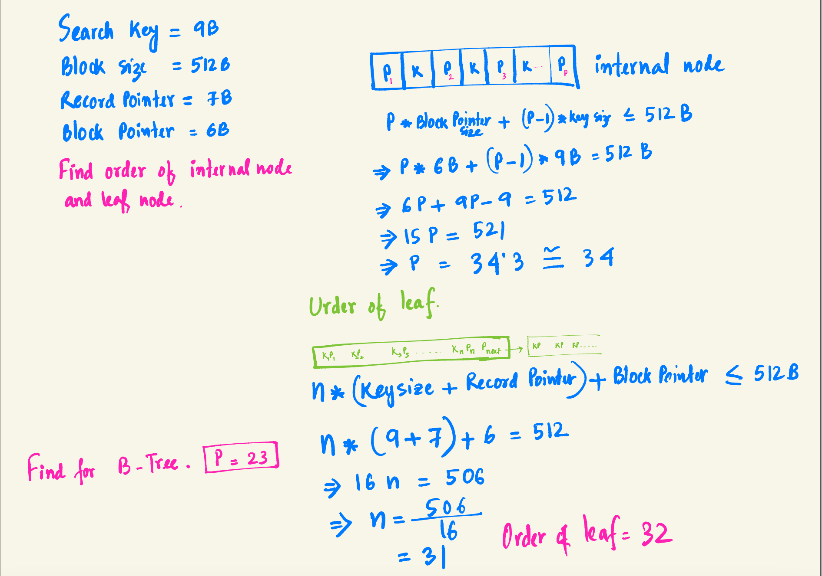
B+ Tree: Exercise
Search key = 9 Bytes
Block size = 512B
Record Pointer = 7B
Block Pointer = 6B
What is order of internal node and leaf node?

Slide 29
B+ Tree: Exercise
In a B+Tree, order of the internal node is 34 and order of the leaf node is 31. If all the nodes of the tree are 70% full, then how many index records will be present in 4 level B+Tree with root at the level 0 and leaves at the level 3.

Slide 30
B+ Tree: Exercise
Which of the following is correct?
(a) B-trees are for storing data on disk and B+ trees are for main memory.
b) Range queries are faster on B+ trees.
(c) B-trees are for primary indexes and B+ trees are for secondary indexes.
(d) The height of a B+ tree is independent of the number of records.

Slide 31
B+ Tree Vs B-Tree
Aspect | B-Tree | B+ Tree
Data Location | Stored in both internal and leaf nodes | Stored only in leaf nodes
Range Queries | Slower (needs internal node traversal) | Faster (sequential traversal through leaf nodes)
Use Case Focus | General-purpose indexing | Database systems, file systems, and efficient range queries
Example Systems | Linux ext4, NTFS file indexing | MySQL InnoDB, RocksDB, NTFS directories, HDFS metadata

Slide 32
Real-life Applications
B-Tree
B + Tree
File Systems (e.g., NTFS, ext4, HFS+)
Database Indexing (Primary Index)
Multilevel Indexing in Large Datasets
Block Storage Systems
General-purpose Balanced Search Trees
Database Indexing (Secondary Index)
File System Directory Structures (e.g., NTFS, HFS+)
Key-Value Stores / NoSQL Databases (e.g., LevelDB, RocksDB)
Search Engines and Data Warehouses

