Slide 1

Design & Analysis of Algorithms
Dr. Alakesh Kalita
Mathematics and Computing
IIT ISM Dhanbad

Slide 2
Heap Data structure
&
Heap Sort

Slide 3
Benefit of Heap
Operation | Insert | Search | Find Min | Delete Min
Unsorted Array | O(1) | O(n) | O(n) | O(n)
Sorted Array | O(n) | O(log n) | O(1) | O(n)
Linked List (US) | O(1) | O(n) | O(n) | O(n)
Min Heap | O(log n) | O(n) | O(1) | O(log n)
Max Heap | O(log n) | O(n) | O(1) (Find Max) | O(log n) (Del Max)

Slide 4
Types of Trees
1
Full Binary Tree: Every node has either 0 or 2 children.
2
3
4
5
6
7
1
Complete Binary Tree: All levels are fully filled except possibly the last, which is filled from left to right
2
3
4
5

Slide 5
Array representation of BT
25
1
1
2
3
4
5
6
7
25
13
22
10
11
18
13
13
2
22
3
Index-based parent-child relationships:
Node is at index i
Left child is at 2i.
Right child is at 2i+1.
Parent is at⌊i/2⌋.
10
4
11
5
18
6
13
7

Slide 6
Array representation of incomplete BT
25
1
1
2
3
4
5
6
7
25
13
22
10
13
13
2
22
3
10
4
13
7

Slide 7
Properties of Complete Binary Trees
h = 0 (# edges till the last leaf)
Height (h) of a complete binary tree with n nodes is h = ⌊log⁡₂n⌋.
h = 1
h
Maximum number of nodes (n) in a complete binary tree with height (h) is
  n = 2^{h+1}-1.
h = 3

Slide 8
Cont …
Index of the leaf nodes starts from ⌊n/2⌋+1 to n
1
2
3
4
5
6
7
8
9
10
11
12
13
14
15
Index of the first leaf node = ⌊15/2⌋ + 1
= ⌊7.5⌋ + 1
= 7 +1 = 8

Slide 9
Cont …
Number of nodes in height h
⌈ n / 2^{h+1}⌉
1
2
3
h = 1
4
5
6
7
N(h=1) = ⌈15/2² ⌉
=⌈15/4⌉
= ⌈3.74⌉
= 4
8
9
10
11
12
13
14
15

Slide 10
Heap
A heap is tree-based data structure
Almost complete binary tree is used as heap
  Node should be filled level by level
  Node should be added from left to right
Add nodes left to right

Slide 11
Heap

Slide 12
Heap Property
Max Heap: Every parent node is greater than or equal to its child nodes.
  A[Parent(i)] >= A [i]
  A descending order list will always be a
Max heap
Min Heap: Every parent node is less than or equal to its child nodes.
  A[Parent(i)] <= A[i]
  A ascending order list will always be a
Min heap
25
13
22
10
11
18
13
Max Heap

Slide 13
Heap Property
The (sub)root nodes of the subtrees must also satisfy the heap property
Leaf nodes inherently satisfy the heap property, as they have no children to compare with.
5
7
10
11
12
13
15
Min Heap

Slide 14
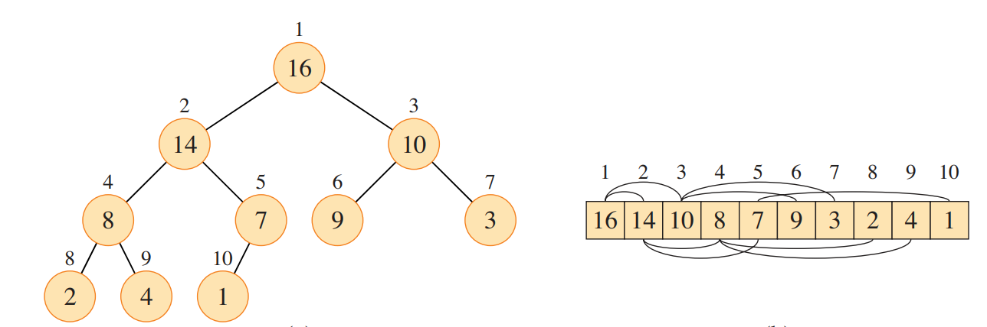
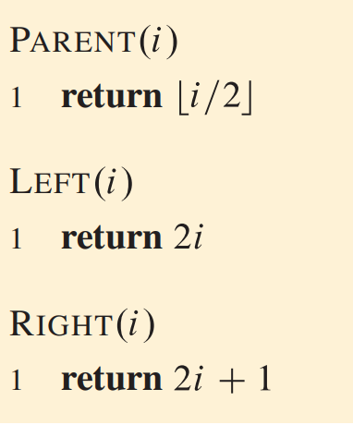
Array representation of Heap

Slide 15
Insertion in an existing heap
25
25
13
22
13
22
10
11
18
10
11
18
1
2
3
4
5
6
1
2
3
4
5
6
7
25
13
22
10
11
18
25
13
22
10
11
18

Slide 16
Insertion in an existing heap
25
25
13
22
13
77
10
11
18
77
10
11
18
22
1
2
3
4
5
6
7
1
2
3
4
5
6
7
25
13
22
10
11
18
77
25
13
77
10
11
18
22

Slide 17
Insertion in an existing heap
25
77
13
77
13
25
10
11
18
22
10
11
18
22
1
2
3
4
5
6
7
1
2
3
4
5
6
7
25
13
77
10
11
18
22
77
13
25
10
11
18
22

Slide 18
Insertion in an existing heap
77
13
25
1
2
3
4
5
6
7
77
13
25
10
11
18
22
10
11
18
22
Maximum number of comparisons = height of the tree = log n = O(log n)
Minimum ???

Slide 19
Insertion in an existing heap
77
13
25
In insertion, we send the elements upwards
10
11
18
22
Maximum number of comparisons = height of the tree = log n = O(log n)
Minimum number of comparisons = 1

Slide 20

Deletion from an existing heap
77
13
25
Only root can be deleted from any heap !!!
10
11
18
22
1
2
3
4
5
6
7
77
13
25
10
11
18
22

Slide 21
Deletion from an existing heap
77
25
13
25
13
10
11
18
22
10
11
18
22
1
2
3
4
5
6
7
1
2
3
4
5
6
7
77
25
13
10
11
18
22
25
13
10
11
18
22

Slide 22
Deletion from an existing heap
22
13
25
Is it a heap now ?
10
11
18
1
2
3
4
5
6
22
13
25
10
11
18
No !!!

Slide 23
Deletion from an existing heap
22
Find the biggest among these three nodes and adjust downward
13
25
10
11
18
1
2
3
4
5
6
22
13
25
10
11
18

Slide 24
Deletion from an existing heap
22
25
13
25
13
22
Try to adjust
10
11
18
10
11
18
1
2
3
4
5
6
1
2
3
4
5
6
22
13
25
10
11
18
25
13
22
10
11
18

Slide 25
Deletion from an existing heap
25
In deletion, adjustment is done downward i.e., towards the leaf nodes
13
22
Time complexity for deletion is O(log n)
10
11
18
1
2
3
4
5
6
25
13
22
10
11
18

Slide 26
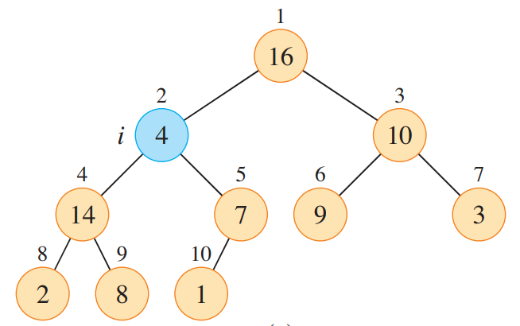
Heapify Procedure
Heapify is a procedure that converts a subtree into a heap
  When heapify is called on a node, it ensures that the subtree rooted at that node follows the heap property.
MAX-HEAPIFY (A, 2)

Slide 27
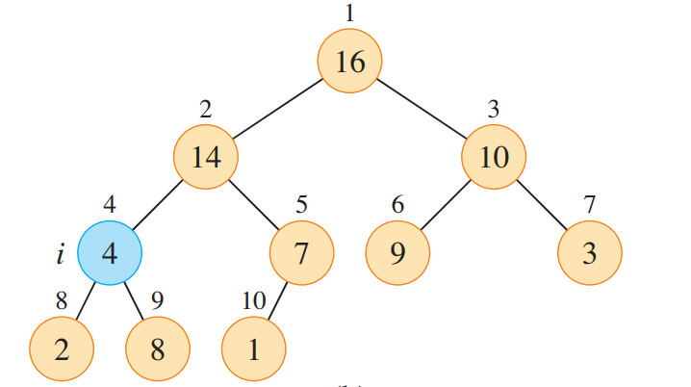
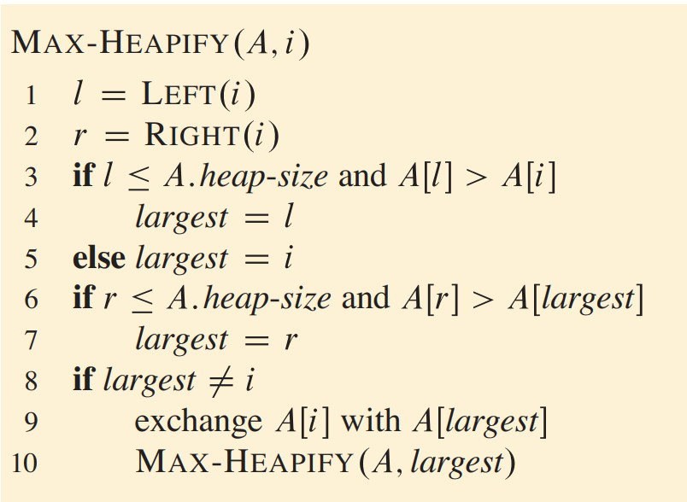
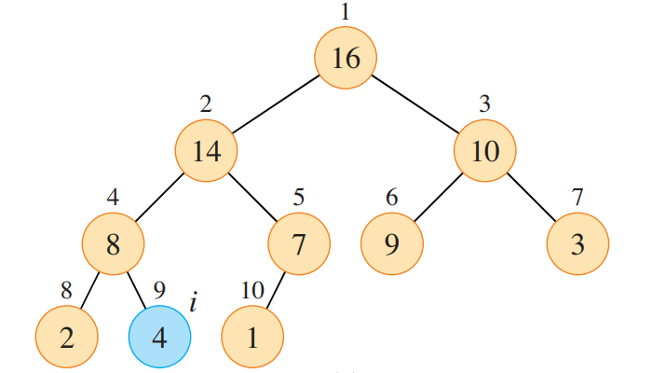
def heapify(arr, n, i):
largest = i # Initialize the largest as current root
left = 2 * i + 1 # Left child index
right = 2 * i + 2 # Right child index
# If the left child exists and is greater than the root
if left < n and arr[left] > arr[largest]:
largest = left
# If the right child exists and is greater than the largest so far
if right < n and arr[right] > arr[largest]:
largest = right
# If the largest is not the root
if largest != i:
# Swap the root with the largest child
arr[i], arr[largest] = arr[largest], arr[i]
# Recursively heapify the affected subtree
heapify(arr, n, largest)
Finding the largest among three nodes
Swapping

Slide 28

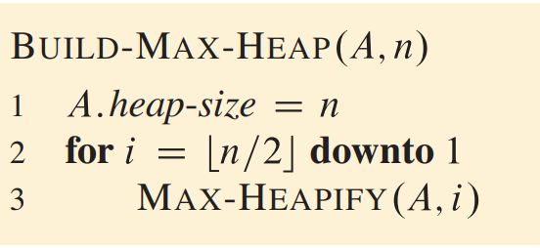
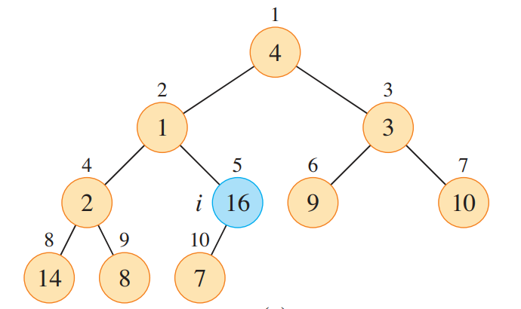
Building a Heap
def build_max_heap(arr):
n = len(arr)
# Start from the last non-leaf node and move upward
for i in range(n // 2 - 1, -1, -1):
heapify(arr, n, i)

Slide 29
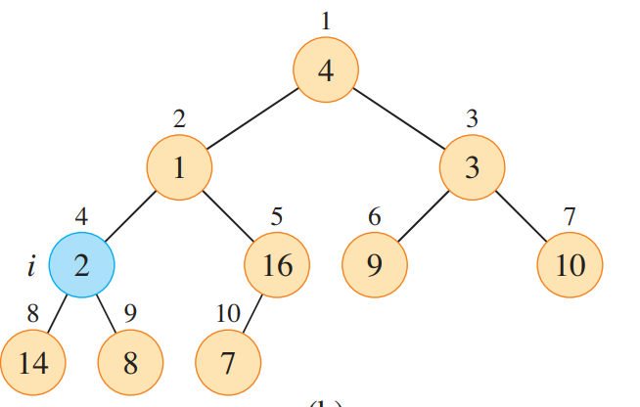
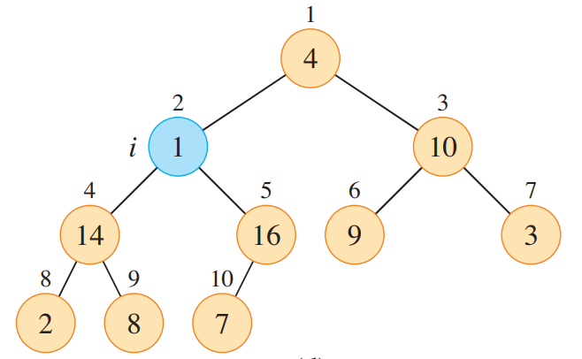
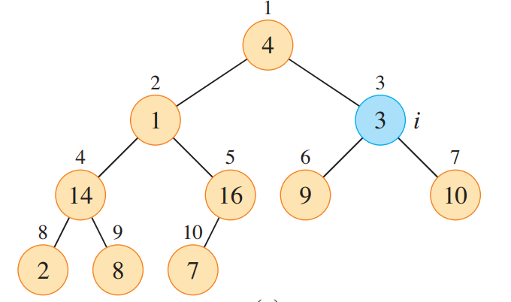

Slide 30
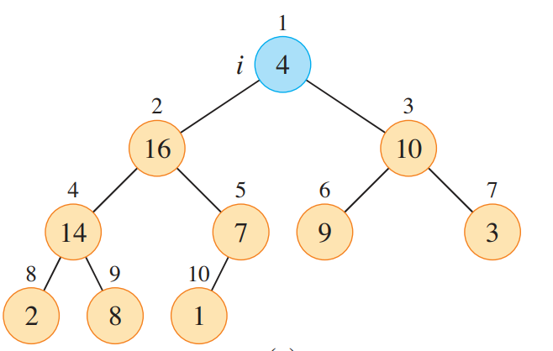
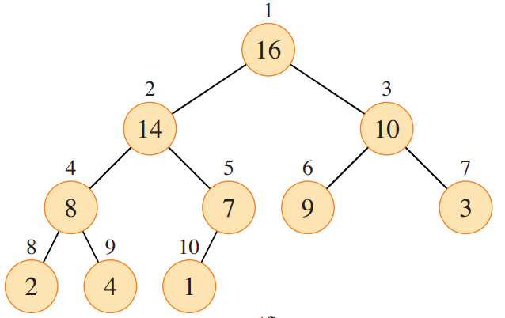

Slide 31
Complexity of building a heap using heapify algo.
Number of nodes in height h
⌈ n / 2^{h+1}⌉
1
2
3
h = 1
4
5
6
7
N(h=1) = ⌈15/2² ⌉
=⌈15/4⌉
= ⌈3.74⌉
= 4
8
9
10
11
12
13
14
15

Slide 32
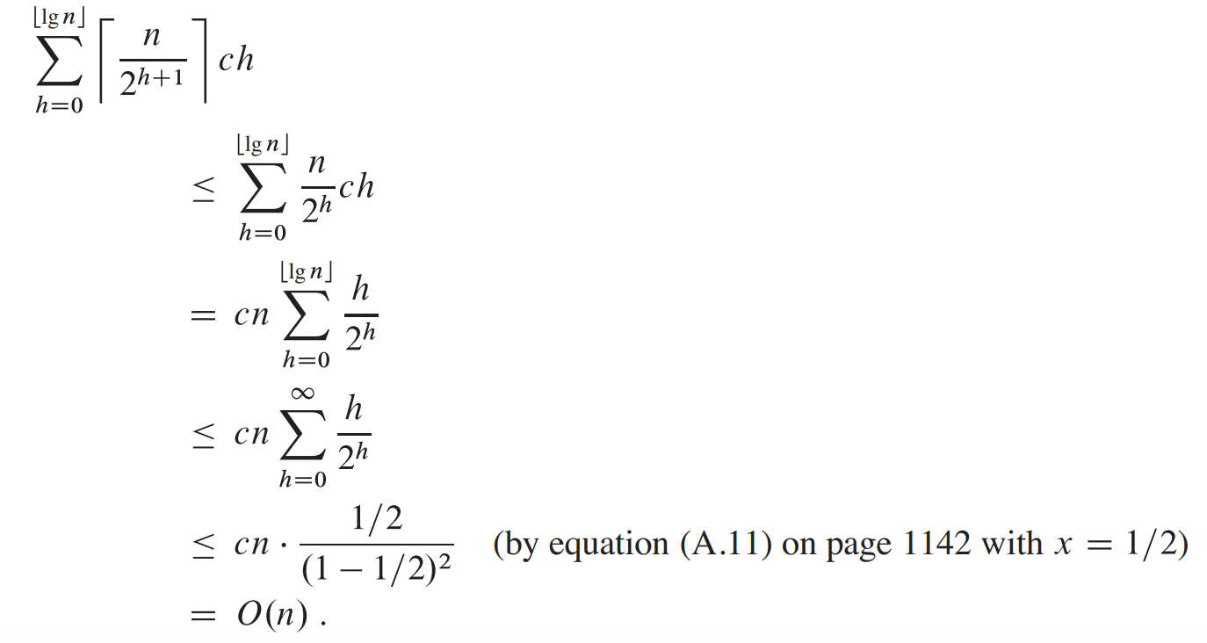
Complexity of building a heap

Slide 33
Why?
Why do we call the heapify algorithm from the last non-leaf node to the root node? Why not in reverse order?
1
1
2
3
5
7
4
5
6
7
4
2
6
3
O(n log n)
O(n)

Slide 34
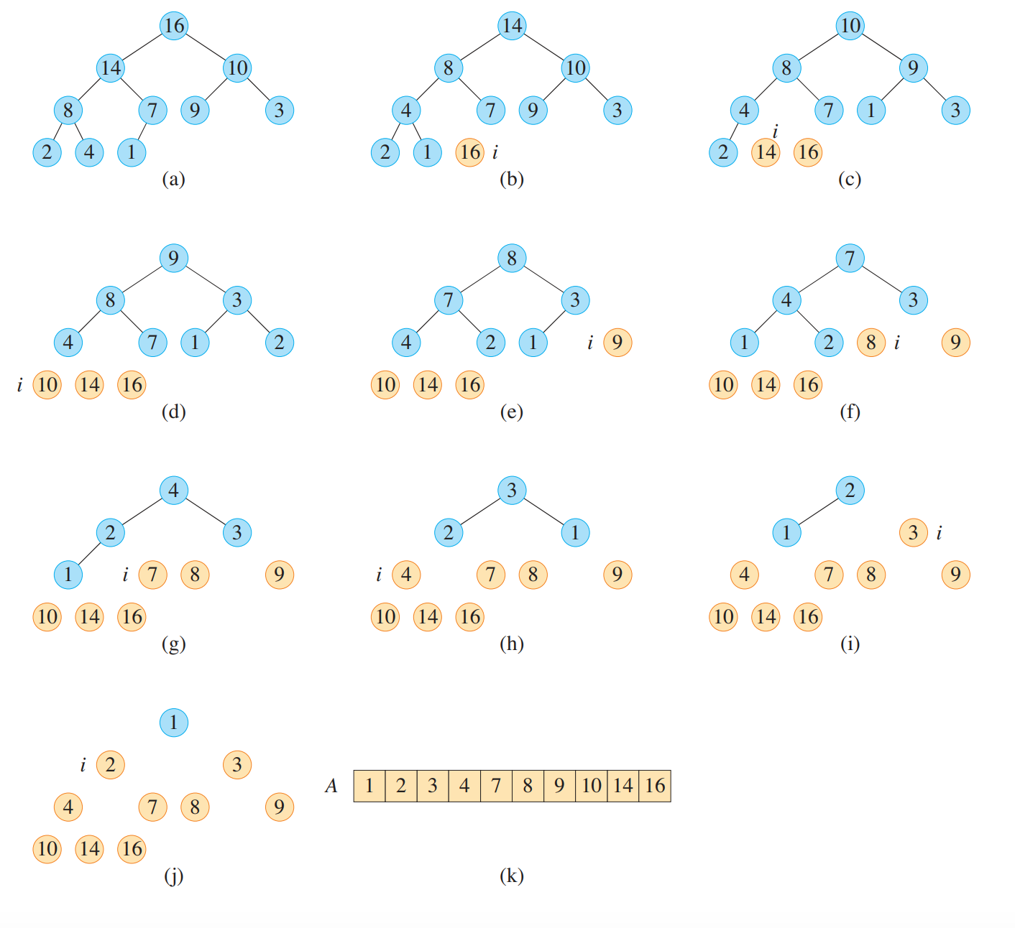
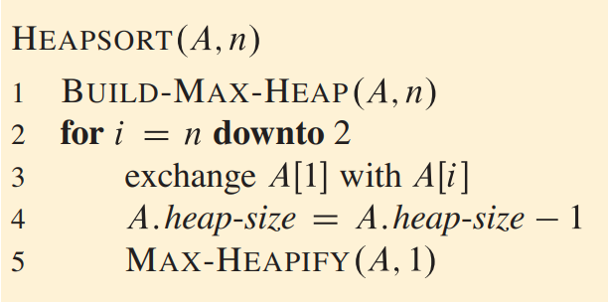
Heap sort

Slide 35
Problems on Heap
Q1: We want to insert “m” more elements into an existing heap with “n”. What would be the time complexity?
Ans: O(n+m)
Q2: What is the time complexity of retrieving the smallest 7th element from a Min Heap of size n?
Ans: O(7 log n) = O(log n)
Q3: In Max heap with n elements, the smallest element can be found in
Ans: O(n/2) = O (n)

Slide 36
Problems on Heap
Q4: In min heap with n elements, the largest element can be found in
Ans: O(n/2) = O (n)
Q5: Time complexity for deleting an arbitrary element from a min heap
Ans: Step 1. Search the element. O(n)
Step 2. Call deletion operation at the index of searched element. O(log n)
Final time complexity: O(n)

Slide 37
Problems
Q6: Write the algorithm for Min-Heapify. Also, show the steps for the given input:
Input: 1, 2, 3, 4, 5, 6, 7, 8, 9
Q7: Write the algorithm for sorting an array in descending order using Heap Sort.
Q8: Identify which sequences follow the Max-Heap, Min-Heap, or neither of these properties.
[95, 84, 78, 60, 72, 50, 66, 32, 45, 55, 68, 10, 30, 42, 25]
[45, 88, 10, 72, 35, 99, 20, 14, 53, 60, 30, 78, 66, 5, 95]
[3, 8, 14, 19, 23, 28, 33, 39, 44, 49, 52, 61, 72, 79, 85]
[23, 74, 51, 90, 32, 18, 41, 77, 62, 11, 99, 6, 48, 85, 13]
[99, 85, 92, 70, 75, 64, 80, 35, 50, 55, 60, 20, 25, 40, 30]

Slide 38
Amortized Time Complexity
Definition:
A method to analyze the average time complexity of an operation over a sequence of operations.
Problem:
Some operations are expensive but rare, while others are cheap and frequent.
Solution:
Amortized analysis averages the cost over a sequence of operations.
Example: Finding the k^{th} smallest element in a given array. k= 1 … n
Can we use linear search?

Slide 39
Amortized Time Complexity
Example: Finding the k^{th} smallest element in a given array
Solution:
Step 1) Sort the given array. O(n logn)
Step 2) Return the K^{th} smallest element. O(1)
If we need to make n such selections then?
n logn
Amortized Time Complexity =
(for each searching)
n
= log n

Slide 40
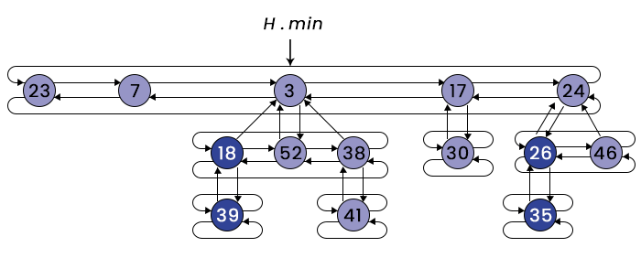
Fibonacci Heap
Amortized Time Complexity:
Insert: O(1)
Find-min: O(1)
Delete-min: O(logn)
Decrease-key: O(1)
Merge: O(1)
Structure: A collection of trees that satisfy the min-heap property.
Flexibility: Supports efficient merging and decrease-key operations.

