Slide 1

Design & Analysis of Algorithms
Dr. Alakesh Kalita
Mathematics and Computing
IIT ISM Dhanbad

Slide 2

Trees

Slide 3
What is a Tree?
Definition
A tree is a hierarchical data structure (non-linear) consisting of nodes.
The top node is called the root.
Nodes can have child nodes connected via edges.
Root
Characteristics
Each child has exactly one parent.
No cycles are present.
1
2
3
4
Edge
5
6
7
8
9
Child(4)
10

Slide 4
Terminologies
1
Root
Root: The topmost node in a tree.
Edge: Connection between two nodes.
Child: A node derived from a parent
2
3
4
Parent (8,9)
Edge
5
6
7
8
9
Child(4)
Parent: A node with children.
Leaf: A node with no children.
10
Leaf

Slide 5
Types of Trees
Binary Tree: Each node has at most two children. A node can have 0, 1 or 2 childrens.
1
Root
2
3
4
5
6
7
8
9
Left subtree
Right subtree
10
Is this a binary tree?
No. Node 1 has 3 childs

Slide 6
Types of Trees
Binary Search Tree (BST): A binary tree where left < root < right.
Root
< root
> root

Slide 7
Types of Trees
1
Full Binary Tree: Every node has either 0 or 2 children.
2
3
4
5
6
7
1
Complete Binary Tree: All levels are fully filled except possibly the last, which is filled from left to right
2
3
AVL Tree: A self-balancing BST.
Heap: A tree with max/min property.
B-Trees: Balanced trees designed for disk storage.
4
5

Slide 8
Types of Trees

Slide 9
Binary Tree Representation
Array Representation
Parent at index i.
Left child: 2i + 1
Right child: 2i + 2
1
2
3
4
5
6
7
1
2
3
4
5
6
7
0
1
2
3
4
5
6

Slide 10
Binary Tree Representation
1
Linked List Representation
Nodes with pointers to left and right children.
2
3
4
5
6
7
L
Root
R
class Node:
def __init__(self,data):
self.data = data
self.left = None
self.right = None
class Tree:
def __init__(self):
self.root = None
L
2
R
L
3
R
L
4
R
L
5
R
L
6
R
L
7
R

Slide 11
Binary Tree Traversals
Inorder (Left, Root, Right)
  Example: 4 -> 2 -> 5 -> 1 -> 6 -> 3 ->7
Preorder (Root, Left, Right)
  Example: 1 -> 2 -> 4 -> 5 -> 3->6->7
Postorder (Left, Right, Root)
  Example: 4 -> 5 -> 2 -> 6 -> 7->3->1
Root
Left subtree
Right subtree
1
2
3
4
5
6
7

Slide 12
Binary Tree Traversals
Inorder (Left, Root, Right)
Root
1
Left subtree
Right subtree
2
3
Inorder : 2 1 3
Left subtree
Right subtree
1
Inorder :
Root
2
3
Displaying records in sorted order when they are stored in a BST.
Inorder :4 2 5 1 6 3 7
4
5
6
7

Slide 13
Binary Tree Traversals
Preorder (Root, Left, Right)
Root
1
Left subtree
Right subtree
2
3
preorder : 1 2 3
Left subtree
Right subtree
1
preorder :
Root
2
3
Displaying a folder hierarchy.
To transfer file directories
preorder : 1 2 4 5 3 6 7
4
5
6
7

Slide 14
Binary Tree Traversals
Postorder (Left, Right,Root)
Root
1
Left subtree
Right subtree
2
3
postorder : 2 3 1
Left subtree
Right subtree
1
postorder :
Root
2
3
postorder : 4 5 2 6 7 3 1
To clean the garbage from computer memory
4
5
6
7

Slide 15
Binary Tree Traversals
1
Inorder (Left, Root, Right)
  Example: 4 -> 2 -> 5 -> 1 -> 6 -> 3 ->7
2
3
4
5
6
7
Algorithm InorderTraversal(node):
if node is not NULL:
InorderTraversal(node.left) // Traverse the left subtree
Visit(node) // Process the current node
InorderTraversal(node.right) // Traverse the right subtree

Slide 16
Binary Tree Traversals
1
Inorder (Left, Root, Right)
  Example: 4 -> 2 -> 5 -> 1 -> 6 -> 3 ->7
2
3
4
5
6
7
Algorithm IterativeInorderTraversal(root):
Initialize an empty stack
Set current = root
while current is not NULL or stack is not empty:
while current is not NULL:
Push current to stack // Traverse to the leftmost node
current = current.left
current = Pop from stack // Backtrack to the last node
Visit(current) // Process the current node
current = current.right // Traverse the right subtree

Slide 17
Binary Tree Traversals
Algorithm IterativeInorderTraversal(root):
Initialize an empty stack
Set current = root
while current is not NULL or stack is not empty:
while current is not NULL:
Push current to stack
current = current.left
current = Pop from stack
Visit/Print(current)
current = current.right
4
2
5
1
1
stack
current =
NULL
left
2
3
root
4
2
5
4
5
6
7
Print =
4
2
5

Slide 18
Binary Tree Traversals
Algorithm (Iterative Preorder using Stack)
Input: root of binary tree
Output: nodes in preorder (Root–Left–Right)
If root == NULL, stop.
Create an empty stack S.
Push root into S.
While S is not empty:
  node = S.pop()
  Visit node (print/process node.data)
  If node.right != NULL, push node.right into S
  If node.left != NULL, push node.left into S
End.

Slide 19
Binary Tree Traversals
Algorithm (Iterative Postorder using two Stacks)
Input: Root of Binary Tree
Output: Postorder traversal
If root == NULL, return.
Create two empty stacks S1 and S2.
Push root into S1.
While S1 is not empty:
  node = S1.pop()
  Push node into S2
  If node.left != NULL, push into S1
  If node.right != NULL, push into S1
While S2 is not empty:
  Visit S2.pop()

Slide 20
Binary Tree Traversals
Algorithm (Iterative Postorder using a single Stack)

Slide 21
Binary Tree Traversals
Preorder (Root, Left, Right)
1
2
3
4
5
6
7
Algorithm PreorderTraversal(node):
if node is not NULL:
Visit(node) // Process the current node
PreorderTraversal(node.left) // Traverse the left subtree
PreorderTraversal(node.right) // Traverse the right subtree

Slide 22
Binary Tree Traversals
Postorder (Left, Right,Root)
1
2
3
4
5
6
7
Algorithm PostorderTraversal(node):
if node is not NULL:
PostorderTraversal(node.left) // Traverse the left subtree
PostorderTraversal(node.right) // Traverse the right subtree
Visit(node) // Process the current node

Slide 23
Binary Tree Traversals
Level order traversal
1
1
2
3
4
5
6
7
2
3
4
5
6
7
Insert an element in BT
Initialize an empty queue.
Enqueue the root node.
Repeat until the queue is empty:
  Dequeue a node and process it.
  Enqueue its left child (if exists).
  Enqueue its right child (if exists).
Which traversal will be useful to delete the entire tree?
BFS: Breadth First Search

Slide 24
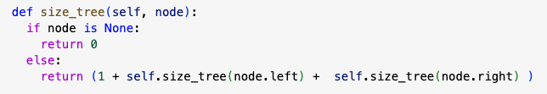
Problems on Binary Tree
Find the size of a binary tree (number of elements)
Find a key in a given binary tree (searching)
Find minimum and maximum element in a binary tree
Delete tree
Find the height of a binary tree
Find the deepest node in a binary tree
Given two binary tree, return true if their structure are same
Find the sum of all elements in a BT
Height(root)
1. If root == NULL
return 0
2. left_height = Height(root.left)
3. right_height = Height(root.right)
4. return 1 + max(left_height, right_height)
SumTree(root)
1. If root == NULL
return 0
2. left_sum = SumTree(root.left)
3. right_sum = SumTree(root.right)
4. return root.data + left_sum + right_sum

Slide 25
Problems on Binary Tree
Inorder sequence: D B E A F C
Preorder sequence: A B D E C F.
Find the postorder sequence.
A
A
DBE
FC
B
C
D
E
F
Note: If one of the sequence is inorder between two sequences, then tree can be identified. Otherwise, not

Slide 26
Binary Search Tree (BST)
Root
A Binary Search Tree (BST) is a binary tree where:
The left subtree contains nodes with values less than the root.
The right subtree contains nodes with values greater than the root.
< root.data
> root.data

Slide 27
BST: Searching
Algorithm in Steps
If root == NULL, return NULL.
If root.data == key, return root.
If key < root.data, recursively call the search on the left subtree with root.left.
If key > root.data, recursively call the search on the right subtree with root.right.
Root
< root.data
> root.data
What is the time complexity?
Does searching on BST always take O(log n)?

Slide 28
BST: Construction
Insert(node, key):
1. If node is NULL:
Create a new node with key and return it.
2. If key < node.data:
node.left = Insert(node.left, key).
3. Else if key > node.data:
node.right = Insert(node.right, key).
4. Return node.
Root
< root.data
> root.data

Slide 29
BST: Construction
Insert(node, key):
1. If node is NULL:
Create a new node with key and return it.
2. If key < node.data:
node.left = Insert(node.left, key).
3. Else if key > node.data:
node.right = Insert(node.right, key).
4. Return node.
arr = [10, 5, 15, 3, 7, 12, 18]
10
What is the avg time complexity of BST construction?
5
15
Ans: O(n logn)
3
7
12
18

Slide 30
BST: Construction
Insert(node, key):
1. If node is NULL:
Create a new node with key and return it.
2. If key < node.data:
node.left = Insert(node.left, key).
3. Else if key > node.data:
node.right = Insert(node.right, key).
4. Return node.
arr = [ 3, 5, 7, 10, 12, 15, 18]
3
Right skewed BST
5
7
What is the worst time complexity for BST construction?
10
Ans: O(n²)
12
Note: Worst time complexity of searching an element in BST is O(n).
15
18

Slide 31
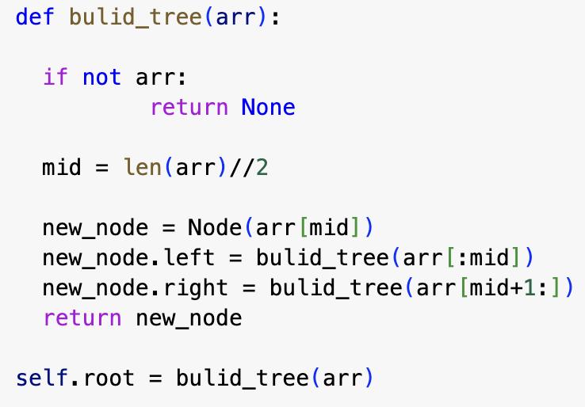
BST: Construction (Balanced)
arr = [ 3, 5, 7, 10, 12, 15, 18]
3
10
5
5
15
7
10
3
7
12
18
Right skewed BST
12
Balanced BST
O(n²)
15
Note: Worst time complexity of searching an element in BST is O(n).
18

Slide 32
BST: Questions
Worst time complexity to find the minimum element in a right skewed BST?
2. Worst time complexity to find the minimum element in a left skewed BST?

Slide 33
BST: Self Study
Delete an element from a BST.

