Slide 1

Design & Analysis of Algorithms
Dr. Alakesh Kalita
Mathematics and Computing
IIT ISM Dhanbad

Slide 2
Linked List

Slide 3
Introduction to Linked Lists
A Linked List is a linear data structure where elements are stored in nodes, and each node points to the next node.
Key Characteristics:
  Dynamic size: Easily grows or shrinks.
  Memory efficient: No need for contiguous memory allocation.
Types of Linked Lists:
  Singly Linked List
  Doubly Linked List
  Circular Linked List

Slide 4
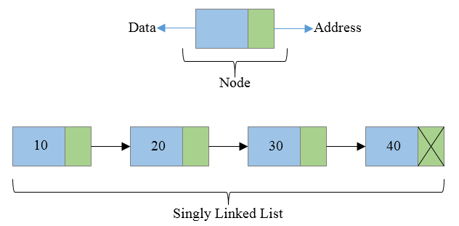
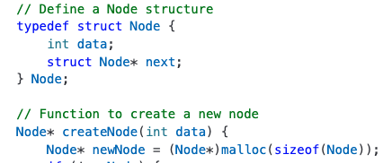
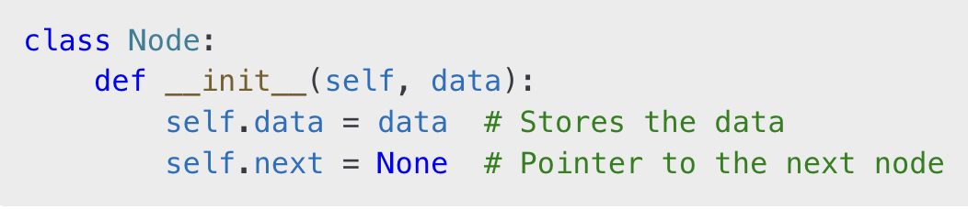
Structure of a Node
Each node in a linked list contains:
  Data: The value stored in the node.
  Pointer: A address (reference) to the next node (or None/NULL/``\0’’ for the last node).

Slide 5
Singly Linked List Overview
Nodes are connected in one direction.
The head pointer references the first node.
The last node’s pointer is None.
head
None

Slide 6
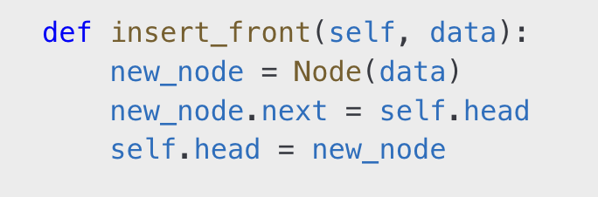
Insertion in a Singly Linked List
Insert at the Front
Steps:
Create a new node.
2. Point its next to the current head.
3. Update the head to the new node.
new
head

Slide 7
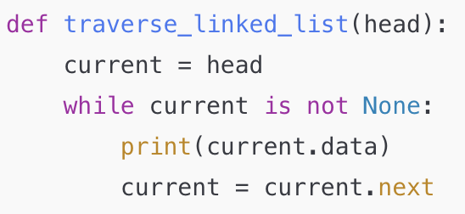
Insertion in a Singly Linked List
Insert in the Middle
Steps:
Traverse to the node just before the desired position.
2. Update the new node’s next to the current node’s next.
3. Update the current node’s next to the new node.
new
head
Current

Slide 8
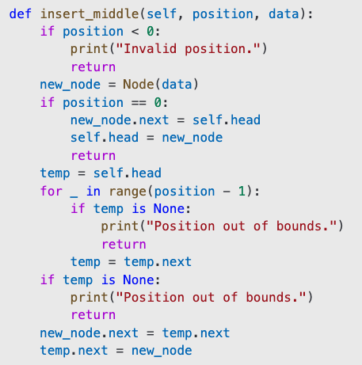
Insertion in a Singly Linked List
Insert in the Middle
new
head
Current

Slide 9

Insertion in a Singly Linked List
Insert in the End
Steps:
1. Traverse to the last node.
2. Update the last node’s next to the new node.
new
Current

Slide 10
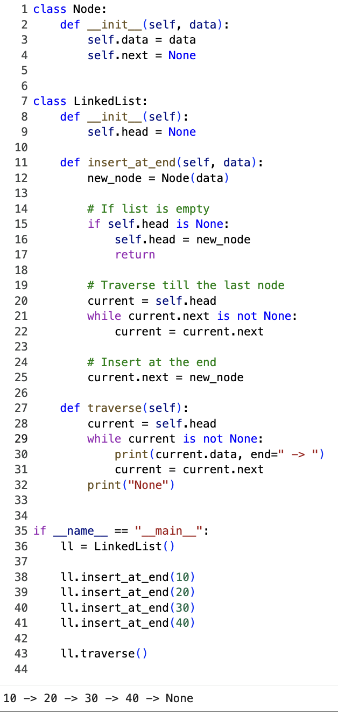
Insertion in a Singly Linked List

Slide 11
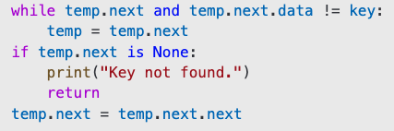

Deletion in a Singly Linked List
Delete from the Front
  Update the head to the next node.
  Free the old head.
Delete from the Middle
  Traverse to the previous node of the target node.
  Update its next to skip the target node.
Delete from the End
    Traverse to the second-last node.
    Update its next to None.

Slide 12
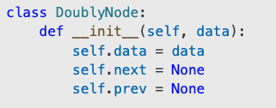
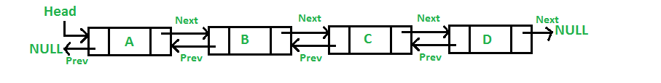
Doubly Linked List Overview
Each node contains:
  Data: The value stored in the node.
  Next Pointer: A reference to the next node.
  Previous Pointer: A reference to the previous node.
Allows traversal in both directions.
The first node’s prev pointer is None, and the last node’s next pointer is None.

Slide 13
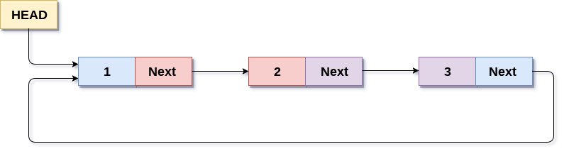
Circular Linked List Overview
Similar to a singly linked list, but the last node’s next points back to the head.
No None values in the list.
Can be singly or doubly circular.

Slide 14
Advantages and Disadvantages
Advantages:
  Dynamic size.
  Efficient memory utilization.
Disadvantages:
  Higher memory usage due to pointers.
  Sequential access (no direct indexing).

Slide 15
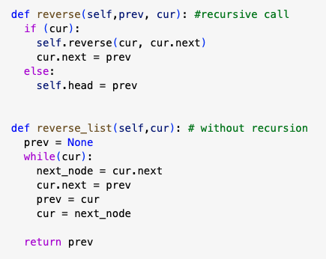
Exercise
  Implement all the operations on singly linked list (insertion, deletion at all the positions)
  Reverse a singly linked list without recursion.
  Reverse a singly linked list using recursion

Slide 16
Stack and Queue Data Structures

Slide 17

Stack Data Structure
A linear data structure that follows the LIFO principle.
LIFO stands for Last In, First Out.
Elements are added and removed from the same end, called the top of the stack.

Slide 18
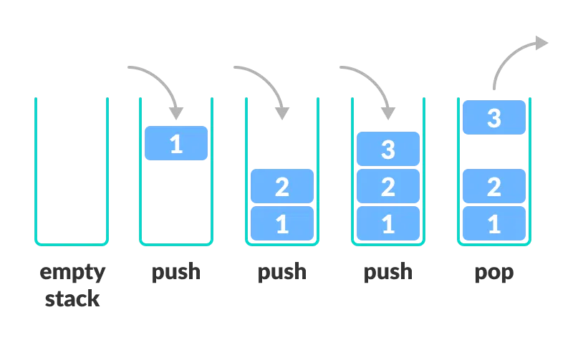
Stack Operations
Push: Add an element to the top of the stack.
Pop: Remove and return the top element of the stack.
Peek: View the top element without removing it.
IsEmpty: Check if the stack is empty.
IsFull: Check if the stack is full (for fixed-size stacks
Or array implementation).

Slide 19
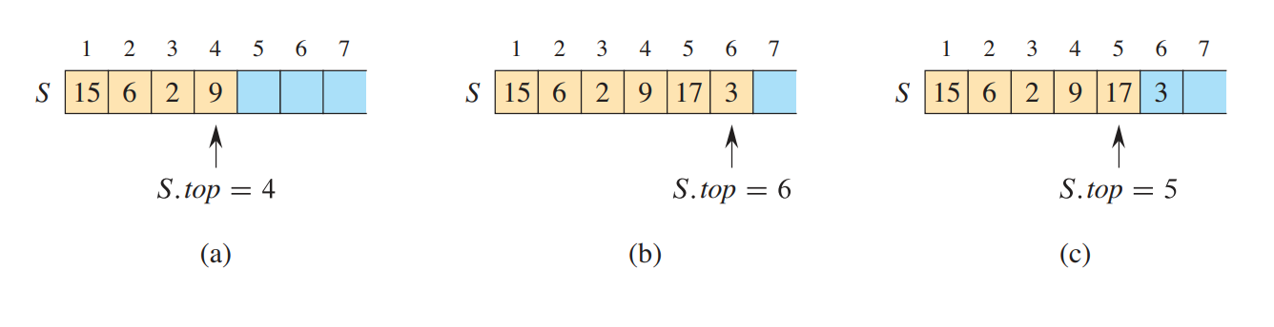
Cond …
(b) Stack S after the calls PUSH(S, 17) and PUSH(S, 3).
(c) Stack S after the calls POP (S).

Slide 20
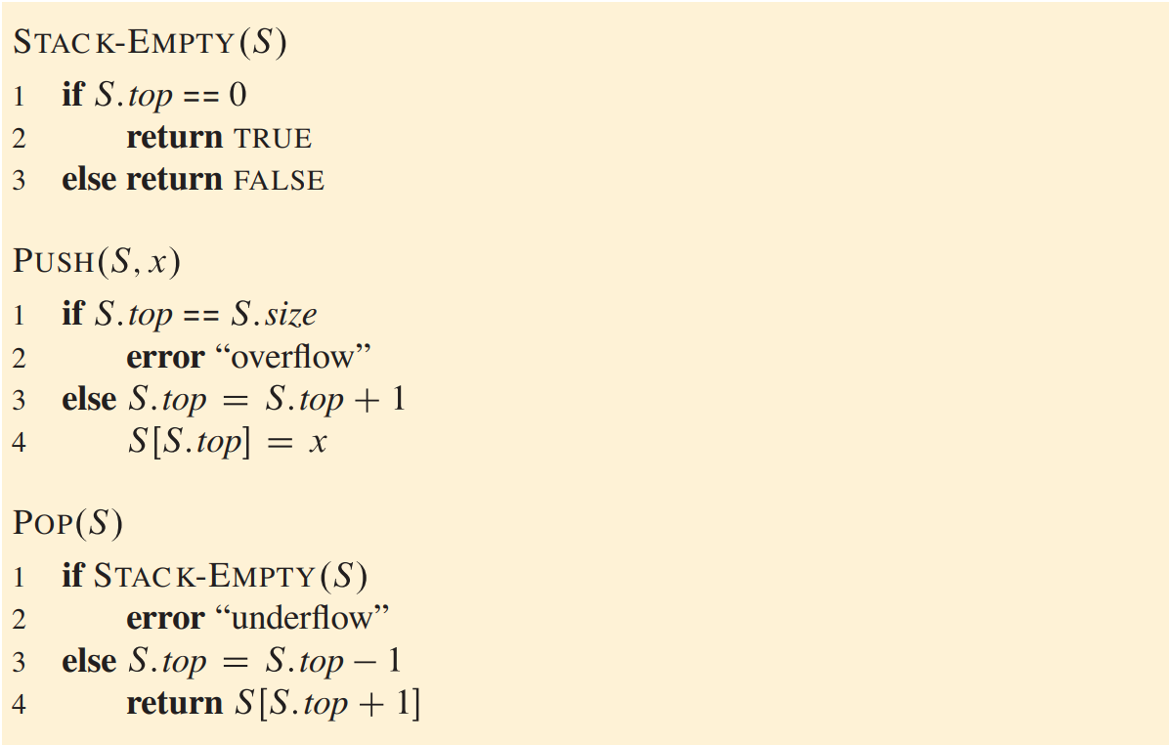
Stack Operations: Algorithms
S.top points to the top element.
S.size max. size of the stack

Slide 21
Exercise
How can you reverse a string using a stack implemented with an array? Write the algorithm.
Explain how a stack can be used to evaluate a postfix expression. Implement it using an array.
  Example: 5 2 3 * +
Implement a program to check if a string has balanced parentheses using a stack implemented with an array.

Slide 22
Queue data structure

Slide 23
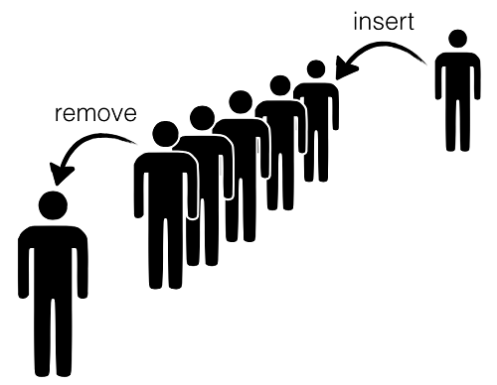
Queue Data Structure
Queue is also linear data structure, but it follows the FIFO principle.
FIFO stands for First In, First Out.
Elements are added and removed from both ends.
  Elements are added at the rear (tail).
  Elements are removed from the front (head).

Slide 24
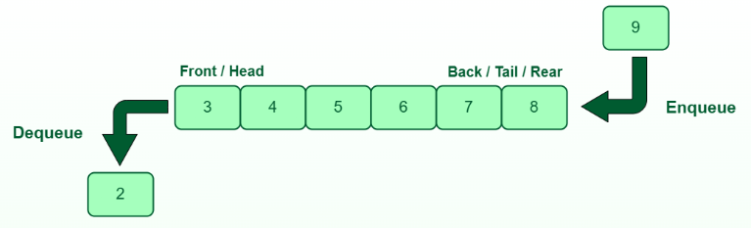
Queue Operations
Enqueue: Add an element at the rear.
Dequeue: Remove an element from the front.
Peek/Front: Retrieve the element at the front without removing it.
IsEmpty: Check if the queue is empty.
IsFull: Check if the queue is full (for array implementation).

Slide 25
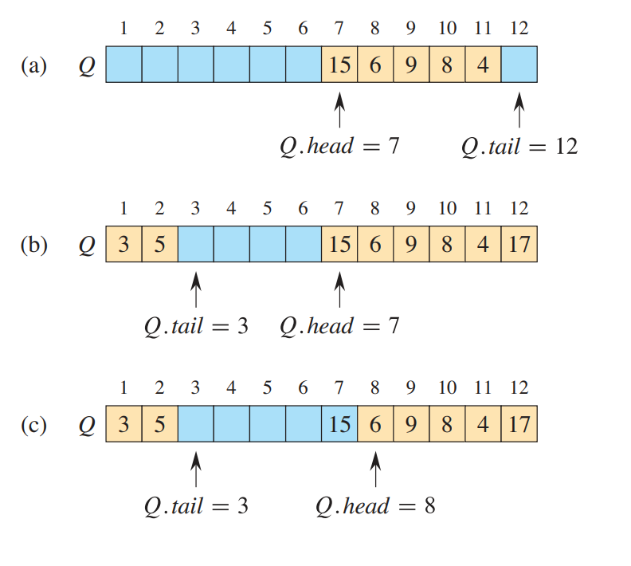
Queue Operations
wrap around: loc 1 immediately follows loc n in a circular order
(b) Enqueue(Q, 17), Enqueue(Q, 3), Enqueue(Q, 5)
(c) Dequeue(Q)

Slide 26
Queue Operations
When is the queue empty?
Q.head = Q.tail
After enqueuing an element, what would be the Q.head and Q.tail?
Q.head = Q.head
Q.tail = Q.head + 1
When a Queue is full?
Q.head = Q.tail + 1 or
(Q.head = 1 and Q.tail = Q.size)

Slide 27
Applications of Queue
Scheduling:
  CPU scheduling.
  Disk scheduling.
Data Streaming:
  Buffer management
Network:
  Packet handling in routers.
Real-life:
  Ticket queues.

Slide 28
Abstract Data Types (ADTs)
Abstract Data Types
An ADT defines a logical concept or behavior without specifying the implementation details.
It focuses on what operations can be performed and their expected behavior rather than how they are implemented.
Examples:
Stack: Follows the Last-In-First-Out (LIFO) principle. Operations include push, pop, and peek.
Queue: Follows the First-In-First-Out (FIFO) principle. Operations include enqueue, dequeue, and peek.

